Slide 1
Customer Segmentation Based on Shopping Trends
Project ID: CDACL-002
Project team’s ID: PTID-CDA-MAY-25-450
Name: Vamshy NK

Slide 2
Objective of the Project
Identify product categories for discount targeting
Analyze spending patterns based on age, location, and season
Perform customer segmentation using clustering
Recommend marketing strategies per segment

Slide 3
Dataset Overview
1000 customer records from U.S. shopping data
Features: Age, Gender, Item Purchased, Category, Purchase Amount, Location, Size, Color, Season, Review Rating, etc.
Goal: Extract insights to improve customer engagement and marketing

Slide 4
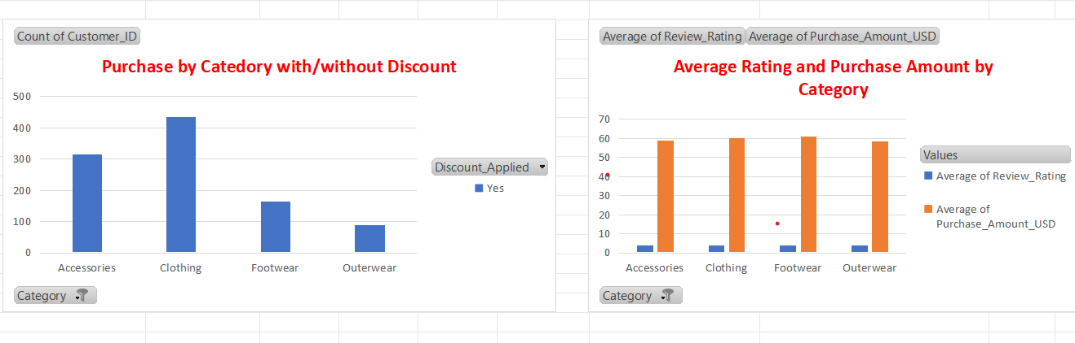
Discount Analysis by Product Category
Categories analyzed: Clothing, Accessories, Footwear, Outerwear
Metrics: Discount usage, Avg. review rating, Avg. purchase amount
Insights:
Clothing had the highest discount usage
Accessories had strong ratings but fewer discounts
Footwear had high value per purchase

Slide 5
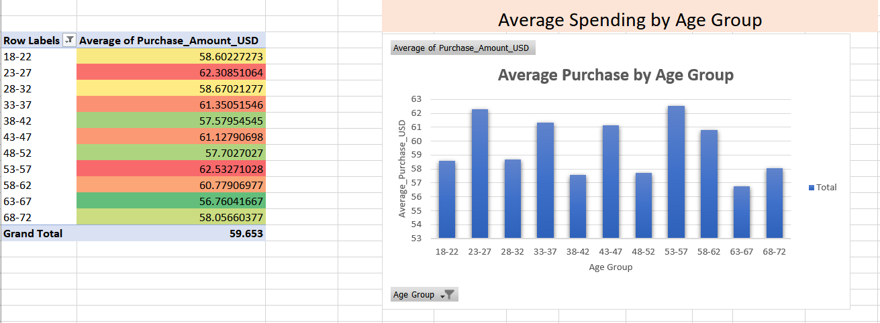
Spend Analysis by Age Group
Age groups segmented (e.g., 18–22, 23–27, etc.)
Chart: Avg. purchase amount by age
Insights:
23–27 and 33–37 age groups spend the most
65+ spend the least

Slide 6
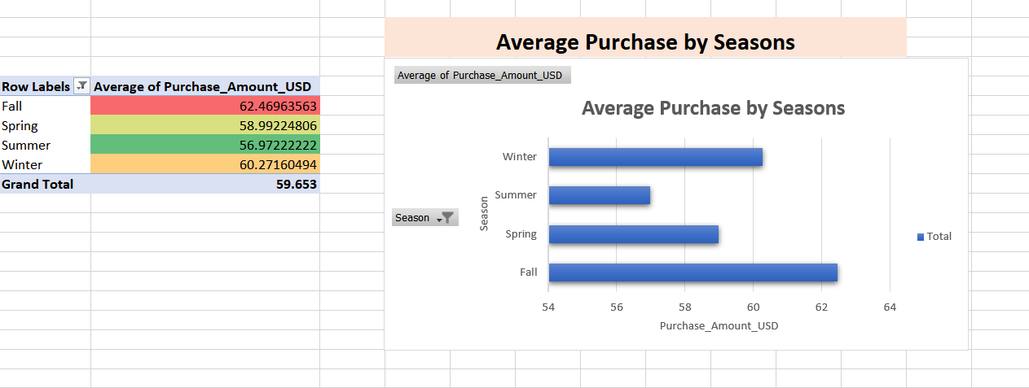
Spend Analysis by Season
Seasons: Winter, Spring, Summer, Fall
Chart: Avg. purchase amount by season
Insights:
Fall and Winter show peak spending
Summer has the lowest purchase activity

Slide 7
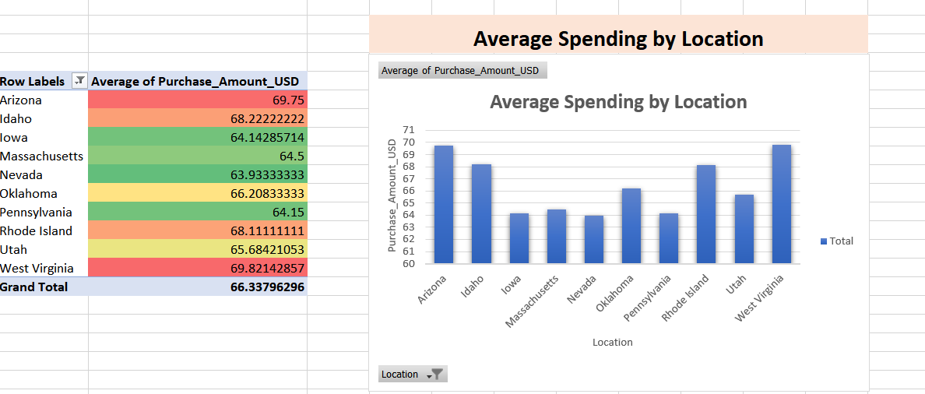
Spend Analysis by Location
Top spending states highlighted
Chart: Avg. spend by location
Insights:
Arizona and West Virginia had highest spend per customer
Utah and Iowa were the lowest

Slide 8
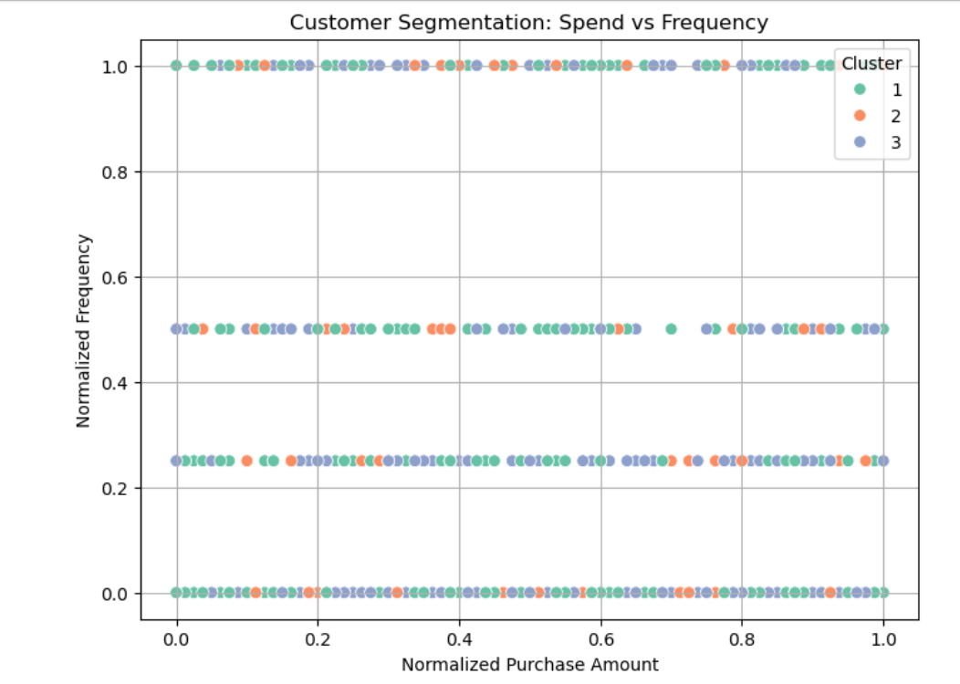
Clustering Overview
K-means clustering with 3 groups
Normalized features: Age, Amount, Rating, Previous Purchases, Frequency
Scatter plot (optional visual): Spend vs Frequency colored by cluster

Slide 9
Cluster Summaries
Cluster 1: Mid-aged, frequent buyers, moderate spend
Strategy: Loyalty rewards, seasonal offers
Cluster 2: Young, high spenders, very frequent
Strategy: Premium campaigns, VIP programs
Cluster 3: Older, low-frequency, low spend
Strategy: Re-engagement emails, discount coupons

Slide 10
Marketing Strategy Recommendations
Personalize campaigns based on segment behavior
Use cluster insights to:
Improve targeting for promotions
Tailor content by season and location
Launch loyalty or VIP offers for high-value groups

Slide 11
Conclusion
Data-driven segmentation reveals actionable customer insights
Discounts should be rebalanced toward high-rated but under-promoted categories
Season and location insights support targeted sales timing
Clustering enables precision marketing

